Slide 1
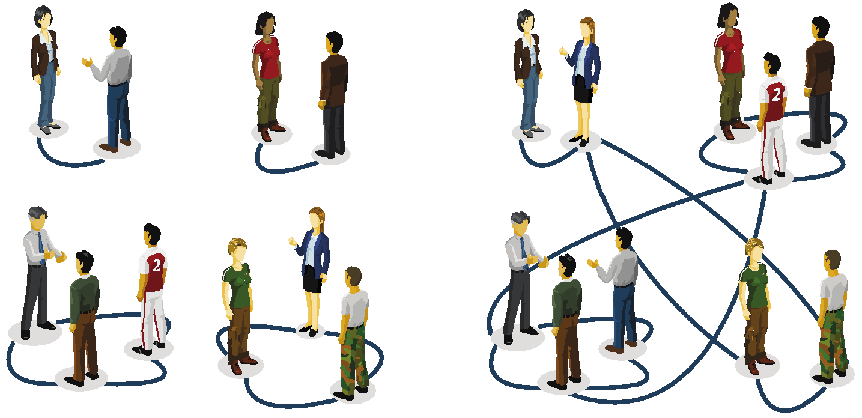
RANDOM NETWORK MODEL
Notes:
Imagine organizing a party for a hundred guests who do not know each other. Offer them wine and cheese, and soon you will see thirty to forty chatting groups of two to three. Now mention to a guest that the red wine in the unlabeled dark green bottles is a rare vintage, better than that with the red label. Ask him to share this information only with his acquaintances and you know that your expensive wine is fairly safe, because your guest has only had time to meet two or three people in the room. However, inevitably the guests will mix, joining other groups and with subtle invisible paths will start connecting people that may still be strangers to each other. For example, while John has not met Mary yet, they have both met Mike, and so there is an invisible path from John to Mary through Mike. As time goes on, the guests will be increasingly interwoven by such intangible links. With that the identity of the expensive wine moves from a tiny group of insiders to more and more chatting groups. To be sure, when all guests had gotten to know each other, everybody would be pouring the superior wine. But if each encounter took only ten minutes, meeting all ninety-nine others would take about sixteen hours. Thus, you could reasonably hope that a few drops of the better wine would be left at the end of the party.
Yet, you would not be more wrong and the purpose of this chapter is to show why. We will see that this problem maps into a classic problem in network science, leading us to the concept of random networks. In turn random network theory will tell us that we do not have to wait until all individuals get to know each other to endanger our expensive wine. Rather, after each person meets at least one other guest, you may find yourself tipping an empty bottle into your expectant glass as everybody could be drinking the reserve wine.
‹#›

Slide 2
Section 3.2
The random network model

Slide 3
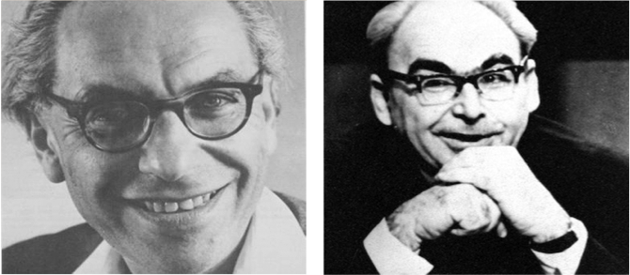
RANDOM NETWORK MODEL
Pál Erdös
(1913-1996)
Alfréd Rényi
(1921-1970)
Erdös-Rényi model (1960)
Connect with probability p
p=1/6 N=10
<k> ~ 1.5

Slide 4
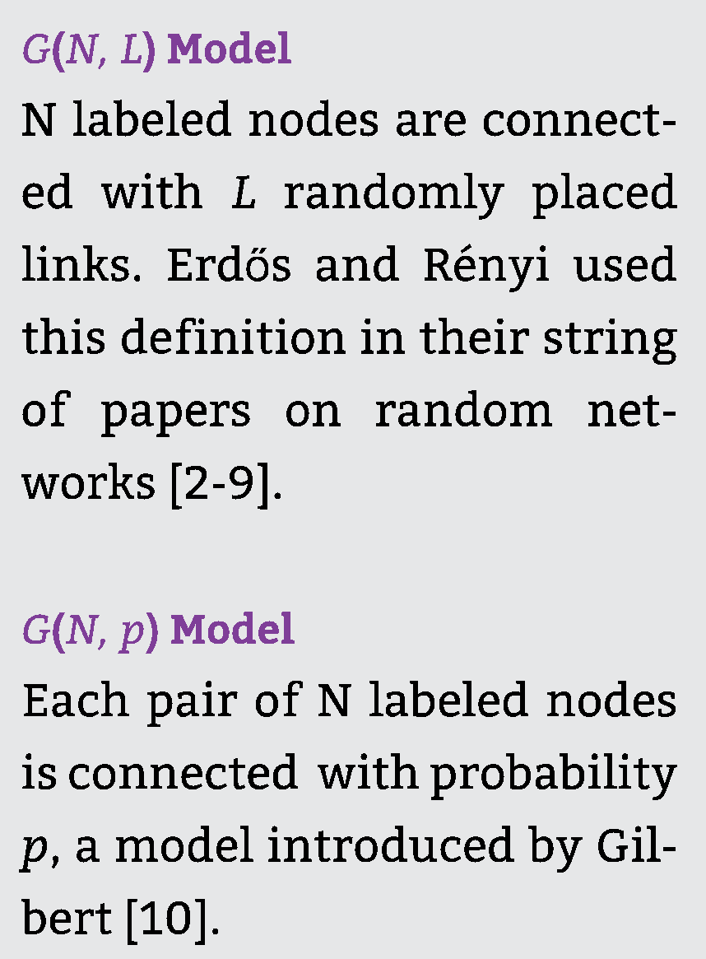
RANDOM NETWORK MODEL
Definition:
A random graph is a graph of N nodes where each pair of nodes is connected by probability p.
Network Science: Random

Slide 5
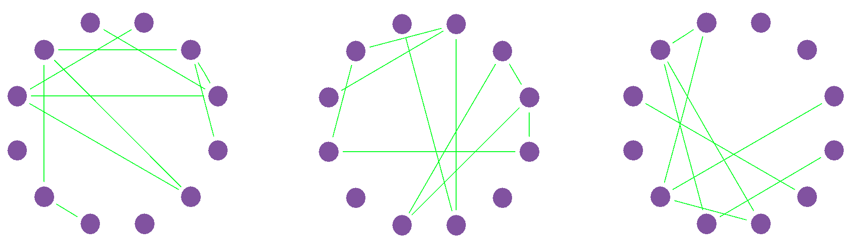
RANDOM NETWORK MODEL
p=1/6
N=12
L=8
L=10
L=7
Notes:
‹#›

Slide 6
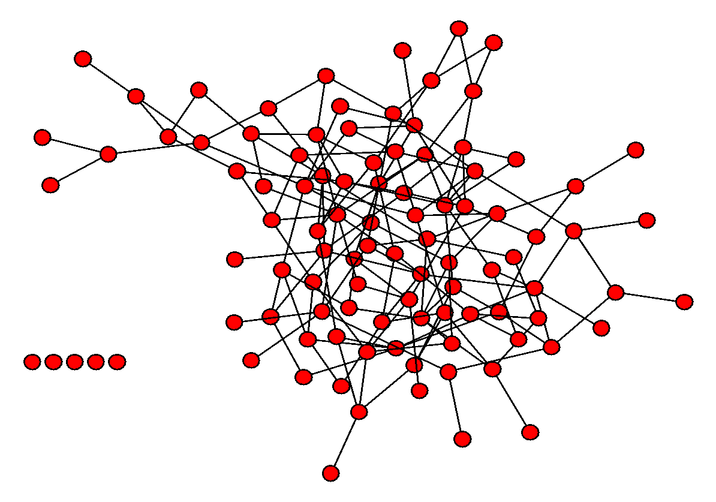
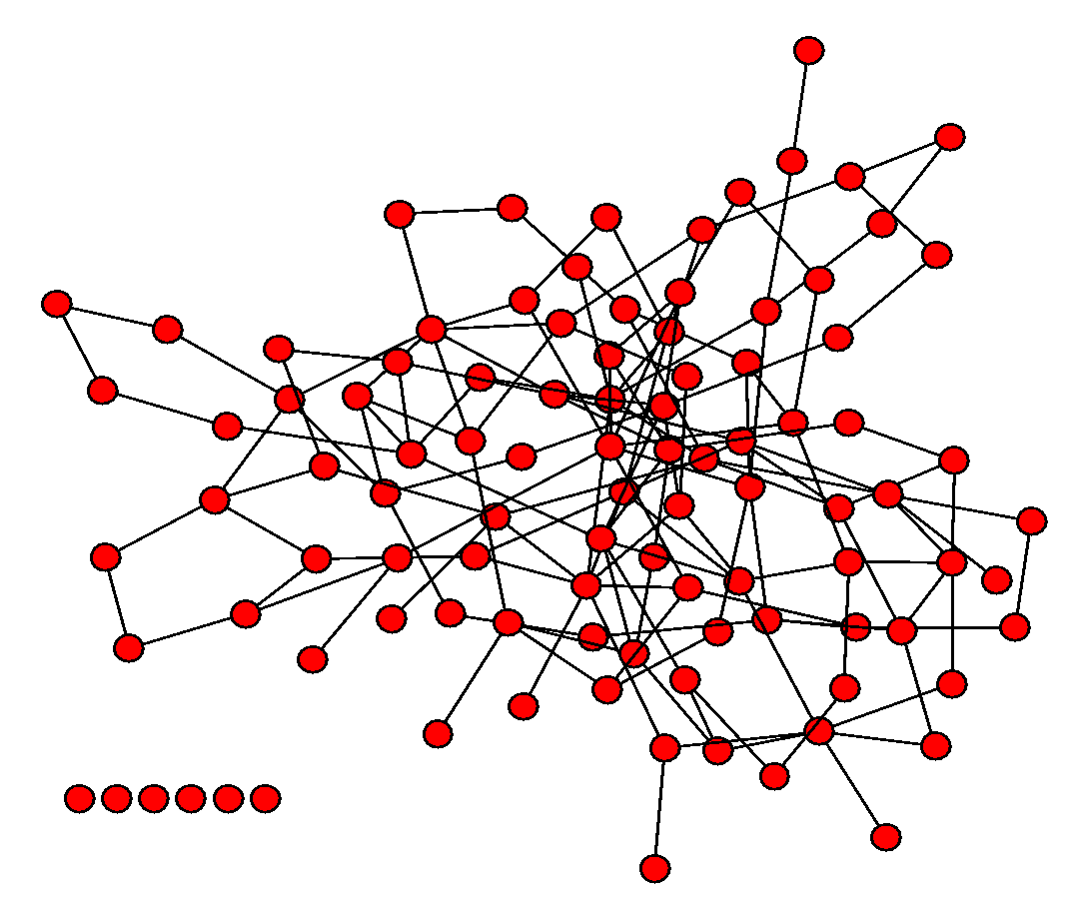
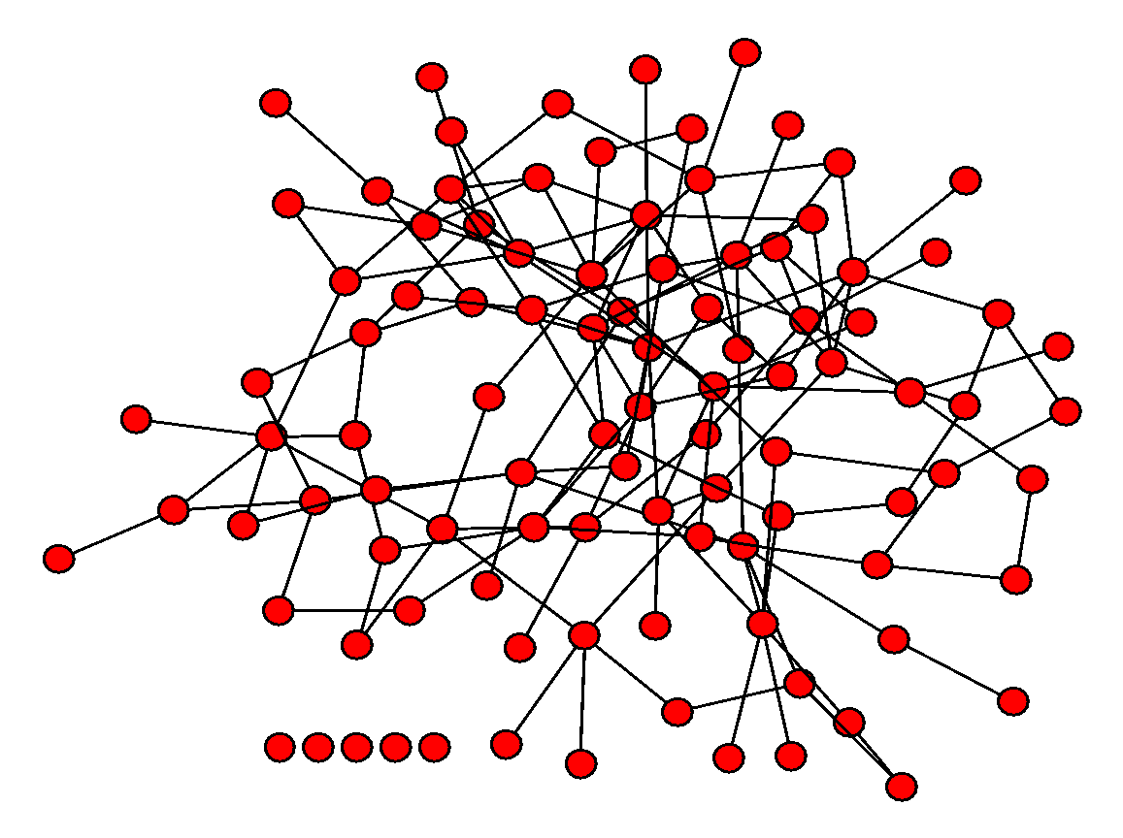
RANDOM NETWORK MODEL
p=0.03
N=100
Notes:
Does look like a real network, does it not?
‹#›

Slide 7
Section 3.3
The number of links is variable

Slide 8
RANDOM NETWORK MODEL
p=1/6
N=12
L=8
L=10
L=7
Notes:
‹#›

Slide 9
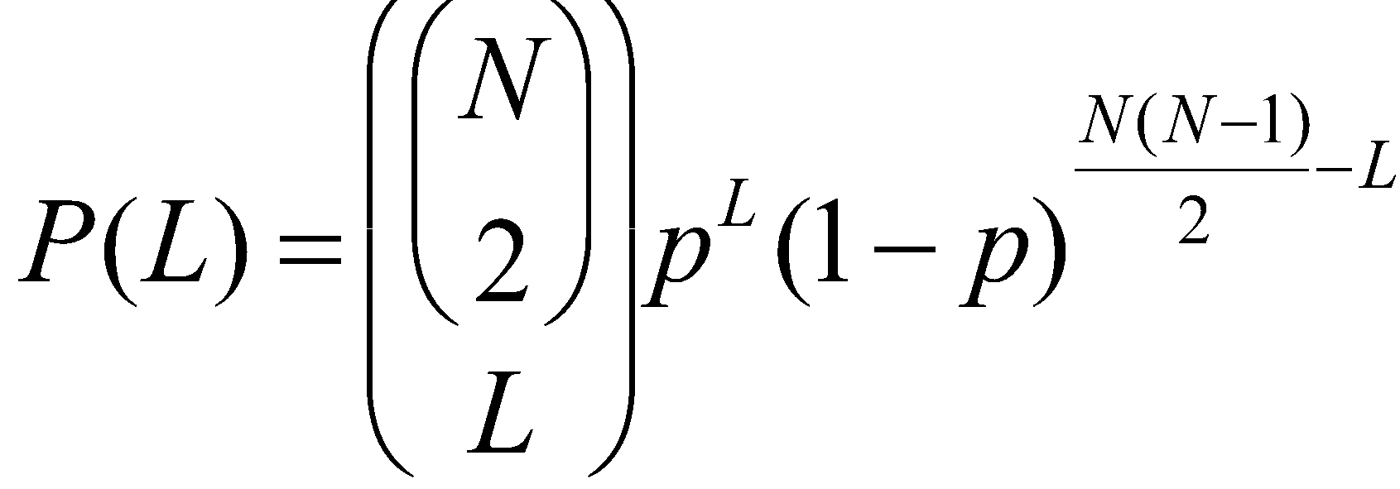
Number of links in a random network
P(L): the probability to have exactly L links in a network of N nodes and probability p:
The maximum number of links in a network of N nodes.
Binomial distribution...
Number of different ways we can choose L links among all potential links.
Network Science: Random Graphs

Slide 10
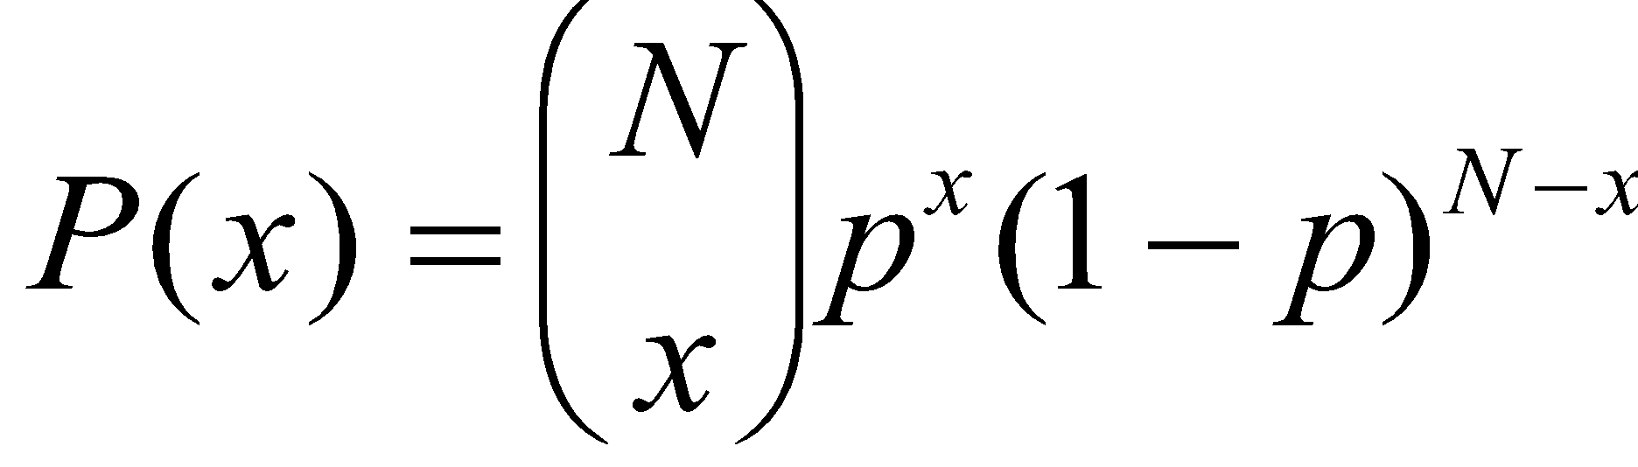
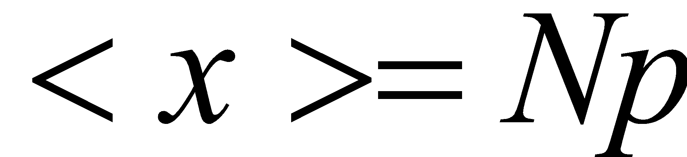
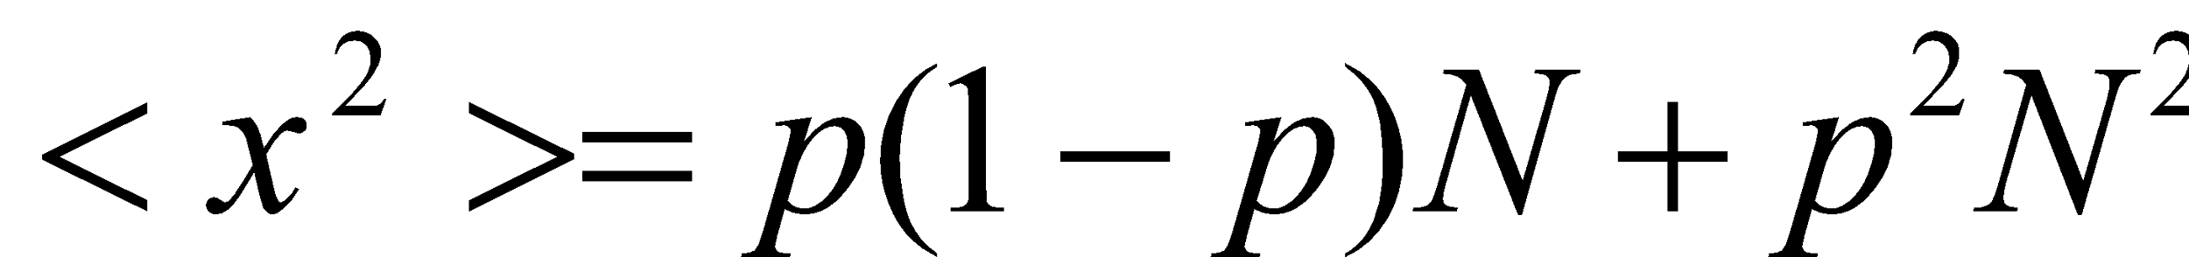
MATH TUTORIAL Binomial Distribution: The bottom line
http://keral2008.blogspot.com/2008/10/derivation-of-mean-and-variance-of.html
Network Science: Random Graphs

Slide 11
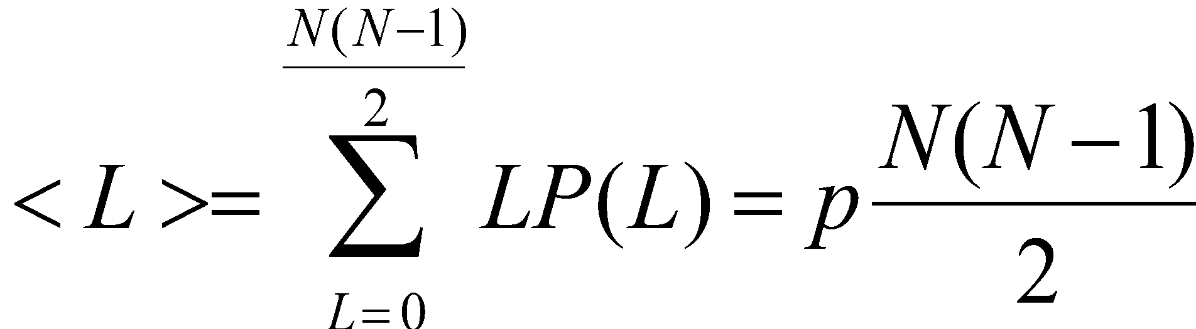
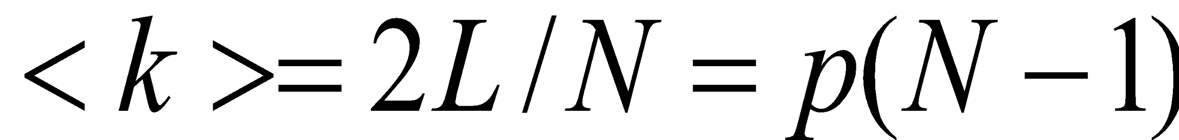
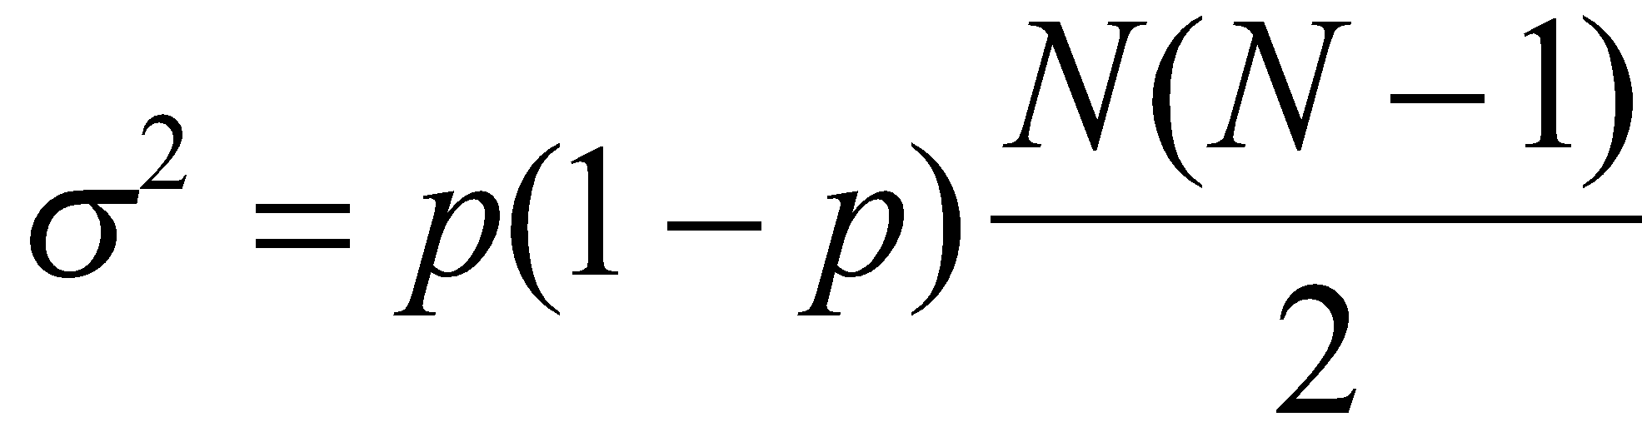
RANDOM NETWORK MODEL
P(L): the probability to have a network of exactly L links
The average number of links <L> in a random graph
The standard deviation
Network Science: Random Graphs
Notes:
Increasing p increases the average number of links increases linearly from L = 0 to L_{max} and the average degree of a node from $\langle k \rangle =0$ to $\langle k \rangle = N-1$ (
. Hence the larger $p$ is, the denser is the network.
‹#›

Slide 12
Section 3.4
Degree distribution

Slide 13
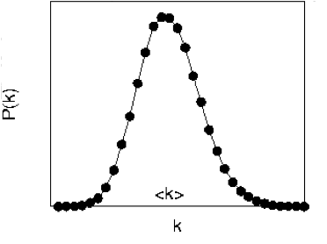
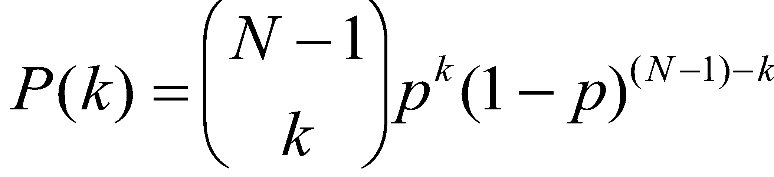
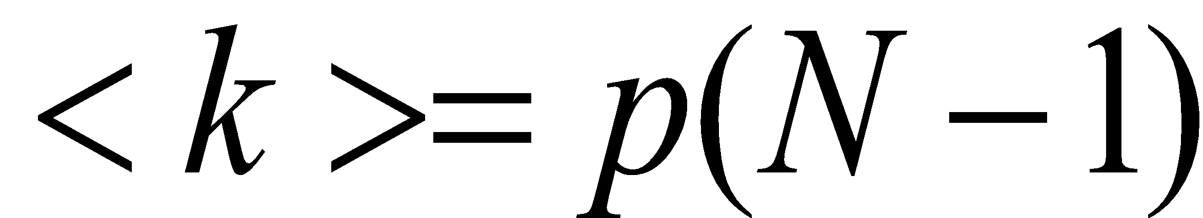
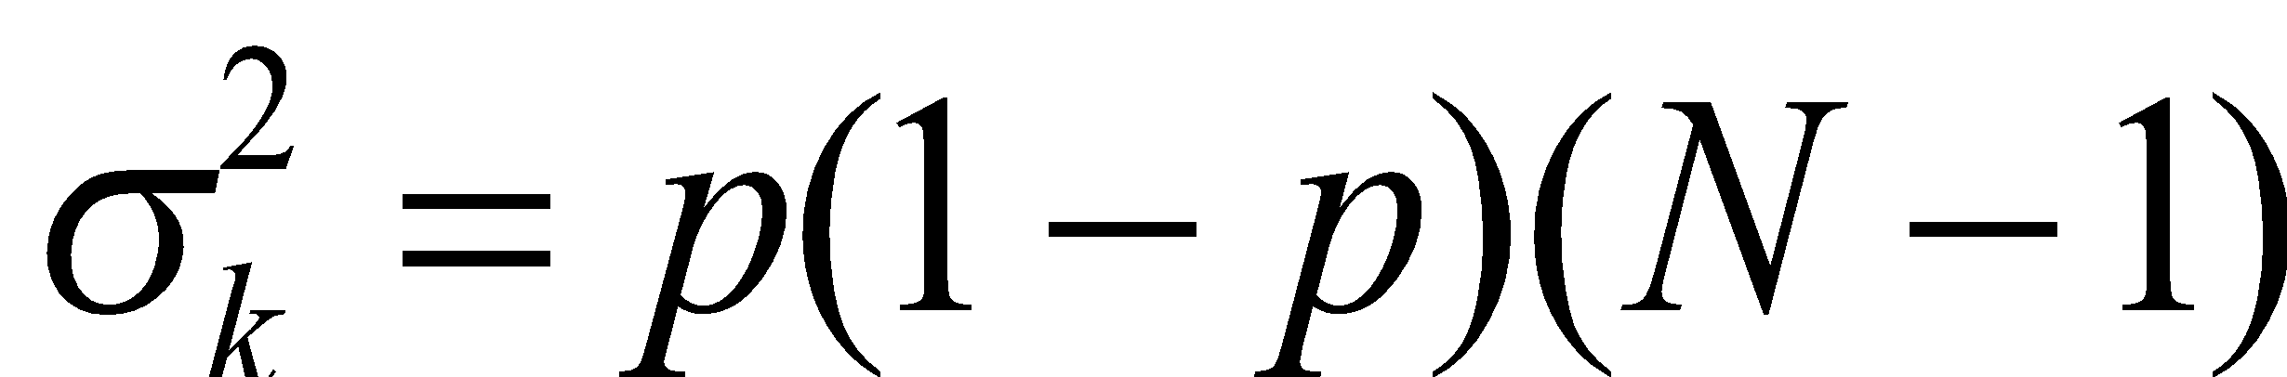
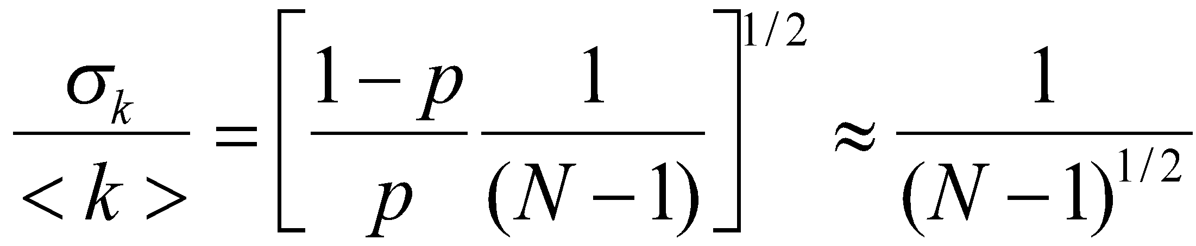
DEGREE DISTRIBUTION OF A RANDOM GRAPH
Select k
nodes from N-1
probability of
missing N-1-k
edges
probability of
having k edges
As the network size increases, the distribution becomes increasingly narrow—we are increasingly confident that the degree of a node is in the vicinity of <k>.
Network Science: Random Graphs

Slide 14
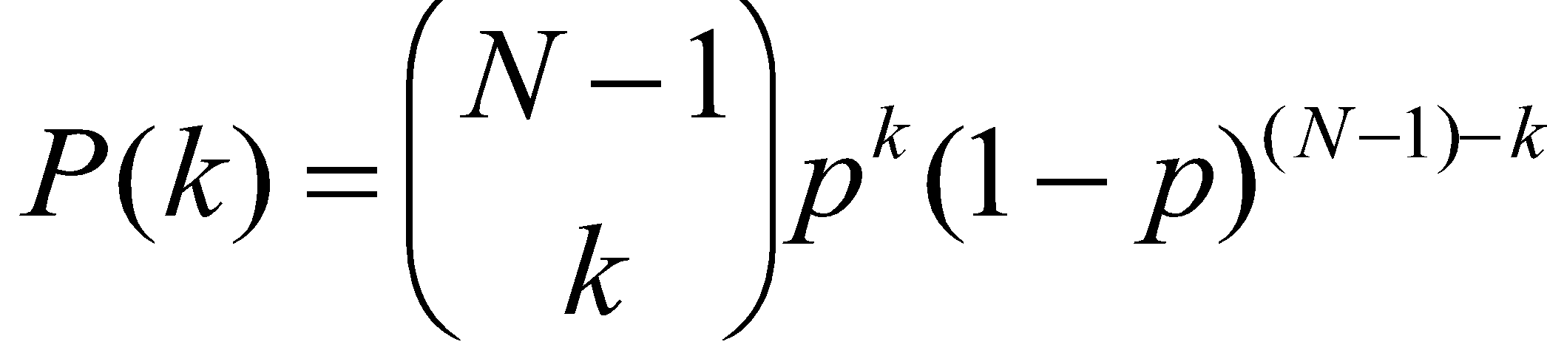
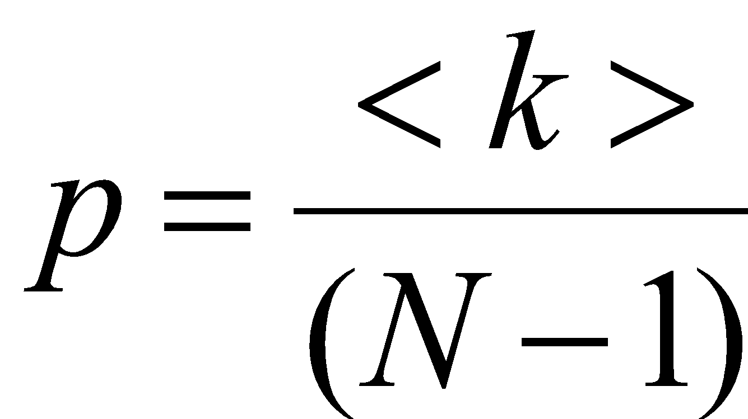
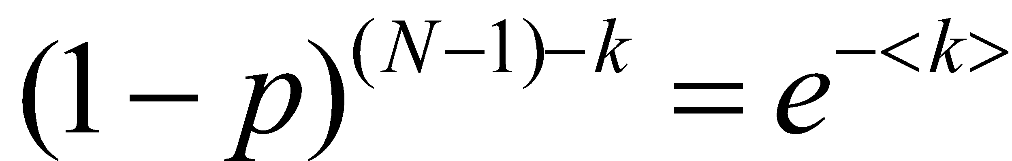
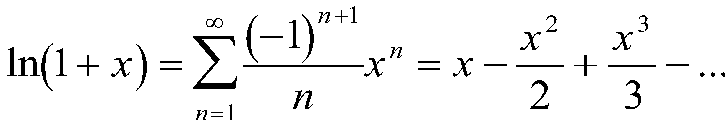
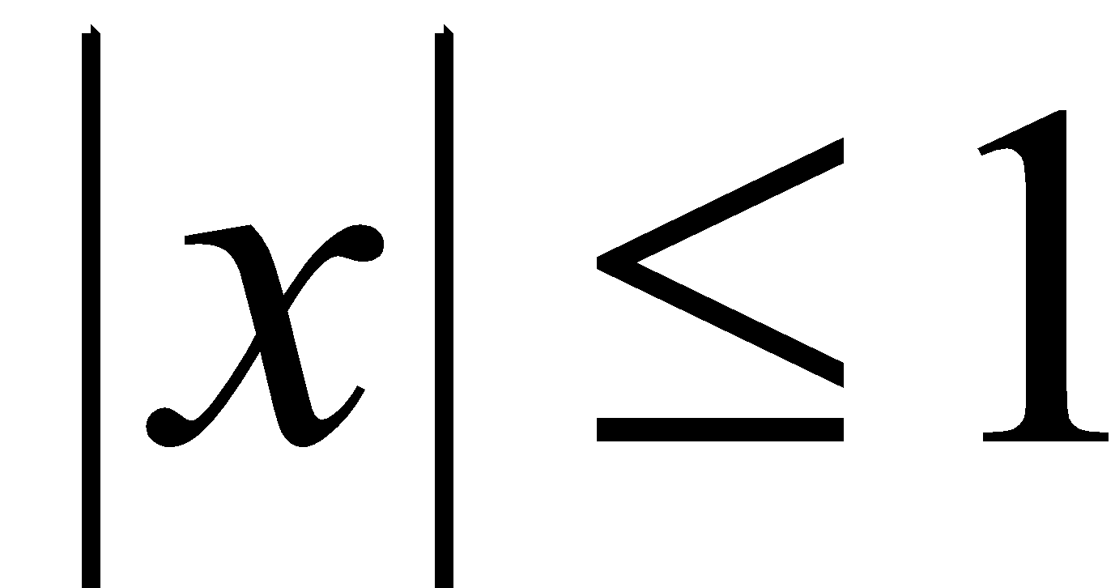
DEGREE DISTRIBUTION OF A RANDOM GRAPH
For large N and small k, we can use the following approximations:
for
Network Science: Random Graphs

Slide 15
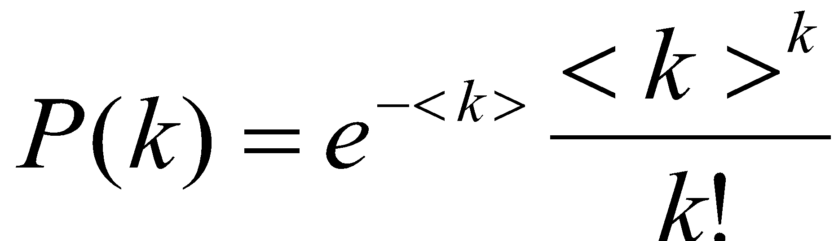
POISSON DEGREE DISTRIBUTION
For large N and small k, we arrive to the Poisson distribution:
Network Science: Random Graphs

Slide 16
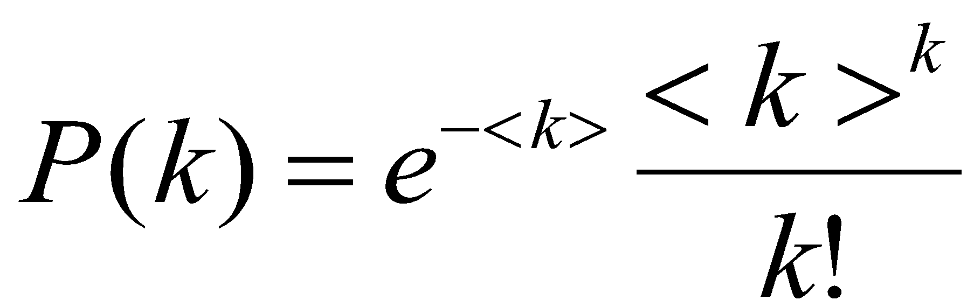
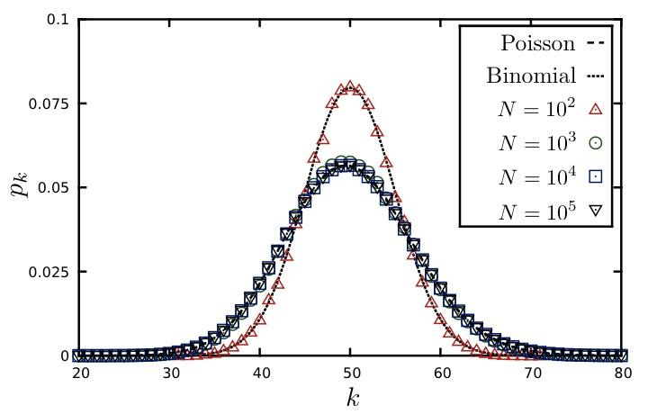
DEGREE DISTRIBUTION OF A RANDOM GRAPH
<k>=50
P(k)
k
Network Science: Random Graphs
Notes:
Note that the exact result for the degree distribution in the binomial form (\ref{P_K}) and (\ref{E-RG-Poisson}) represents only an approximation to (\ref{P_K}) for large $N$. Yet, for $k<<N$, there is no fundamental difference between (\ref{P_K}) and (\ref{E-RG-Poisson}), the Poisson form (\ref{E-RG-Poisson}) simply represents a different way to write (\ref{P_K}) in this limit. The advantage of the Poisson form is that (\ref{E-RG-Poisson}) it does not explicitly depend on the number of nodes $N$. Therefore, it predicts us that the degree distributions of random networks with the same average degree, $\langle k \rangle$, but different sizes, are indistinguishable from each other. This is illustrated in Figure \ref{F-RG-PoissonNDependence}, where we show the degree distribution of several random networks of different sizes, $N$. The figure indicates that while for small $N$ there are differences between the numerically obtained $p_k$ and (\ref{E-RG-Poisson}), for large $N$ the differences vanish and the degree distribution becomes independent of the system
size. \\
‹#›

Slide 17
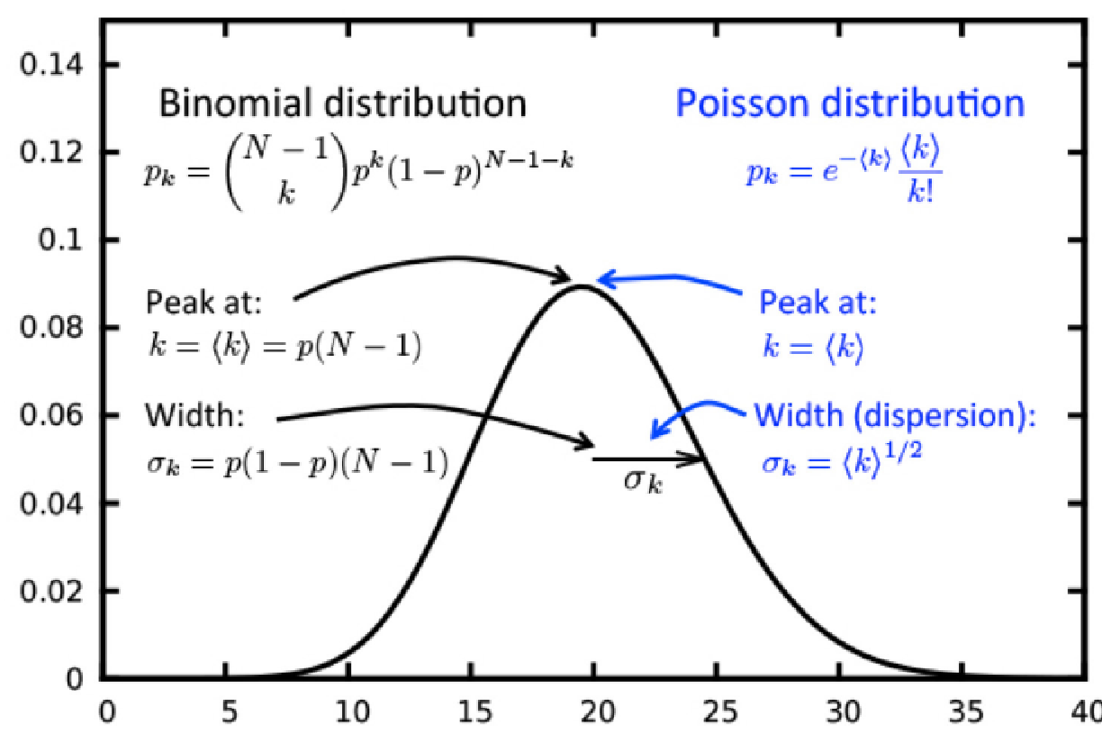
DEGREE DISTRIBUTION OF A RANDOM NETWORK
Exact Result
-binomial distribution-
Large N limit
-Poisson distribution-
Probability Distribution Function
(PDF)

Slide 18
Section 3.4
Real Networks are not Poisson

Slide 19
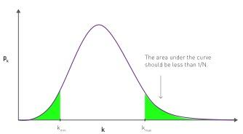
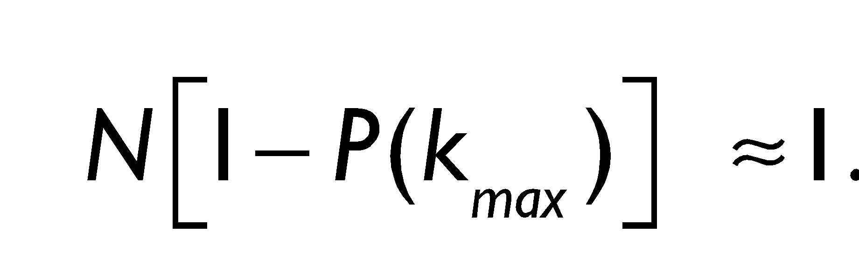
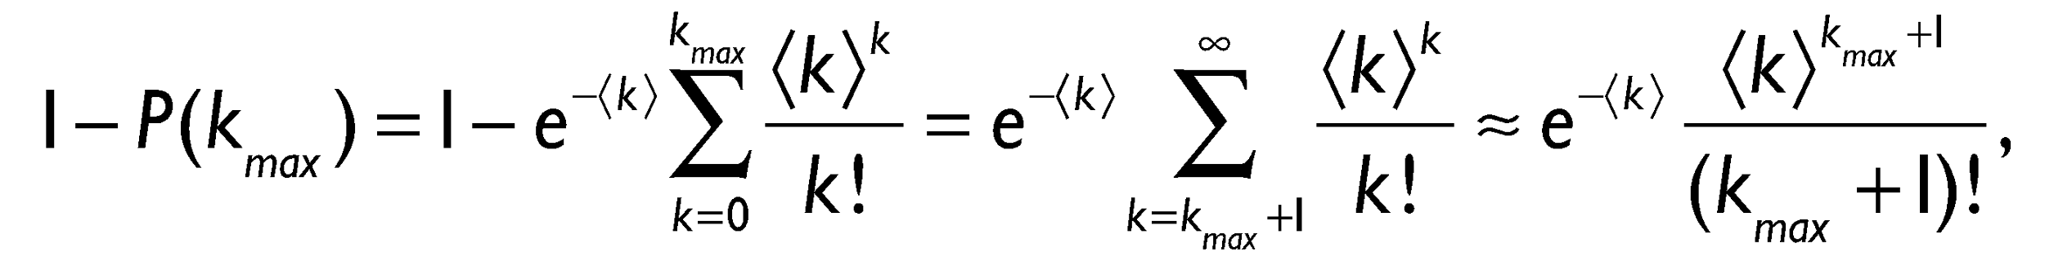

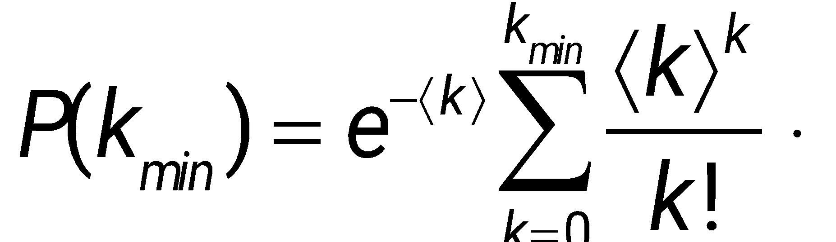
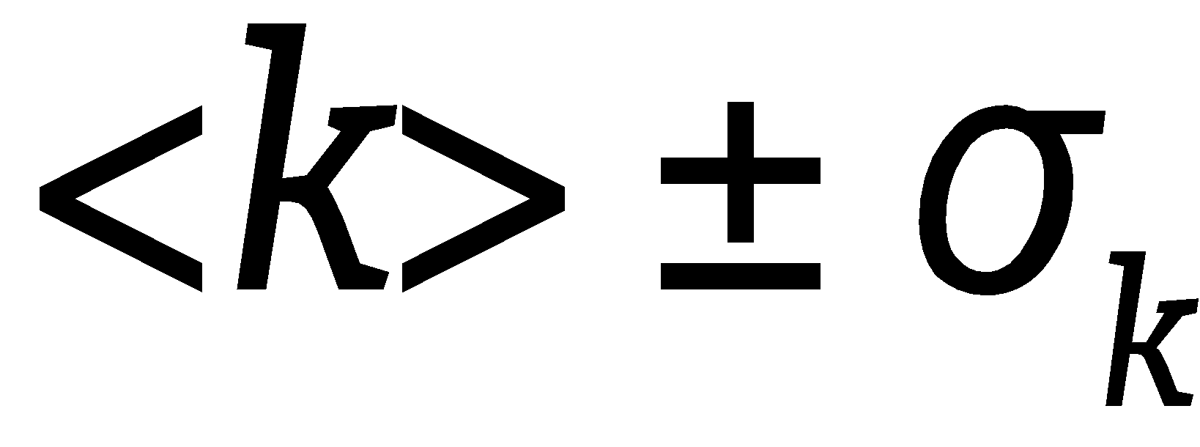
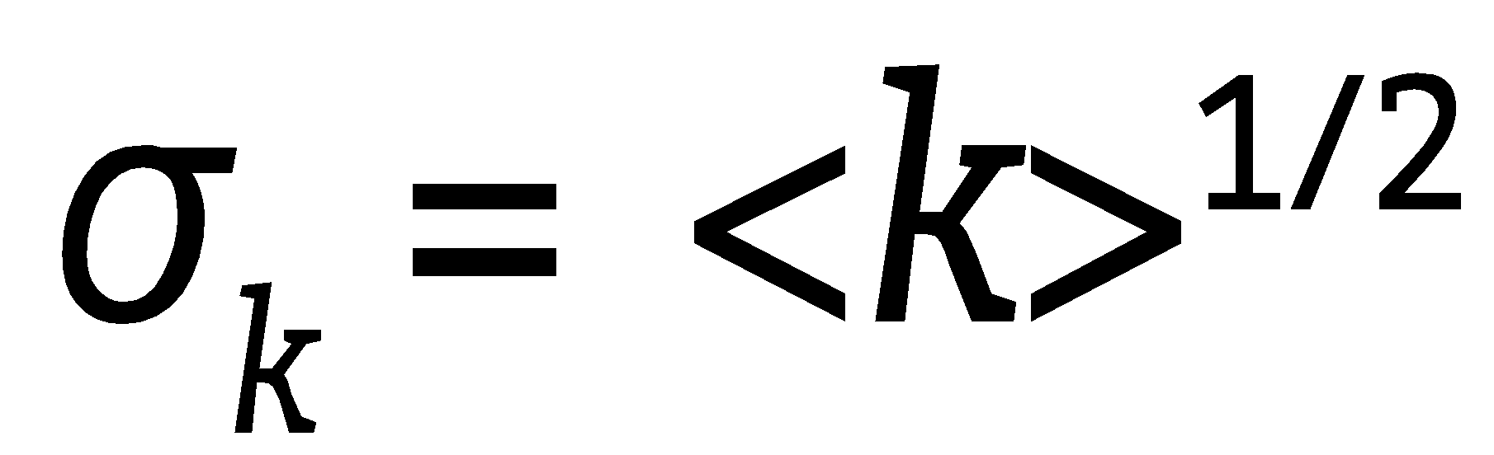
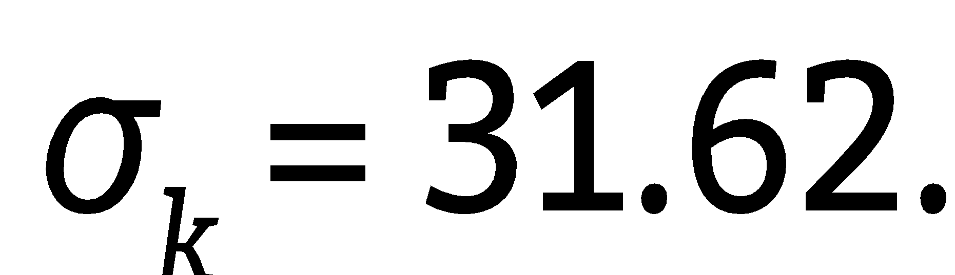
Section 3.5 Maximum and minimum degree
<k>=1,000, N=10⁹
<k>=1,000, N=10⁹
k_{max}=1,185
k_{min}=816

Slide 20
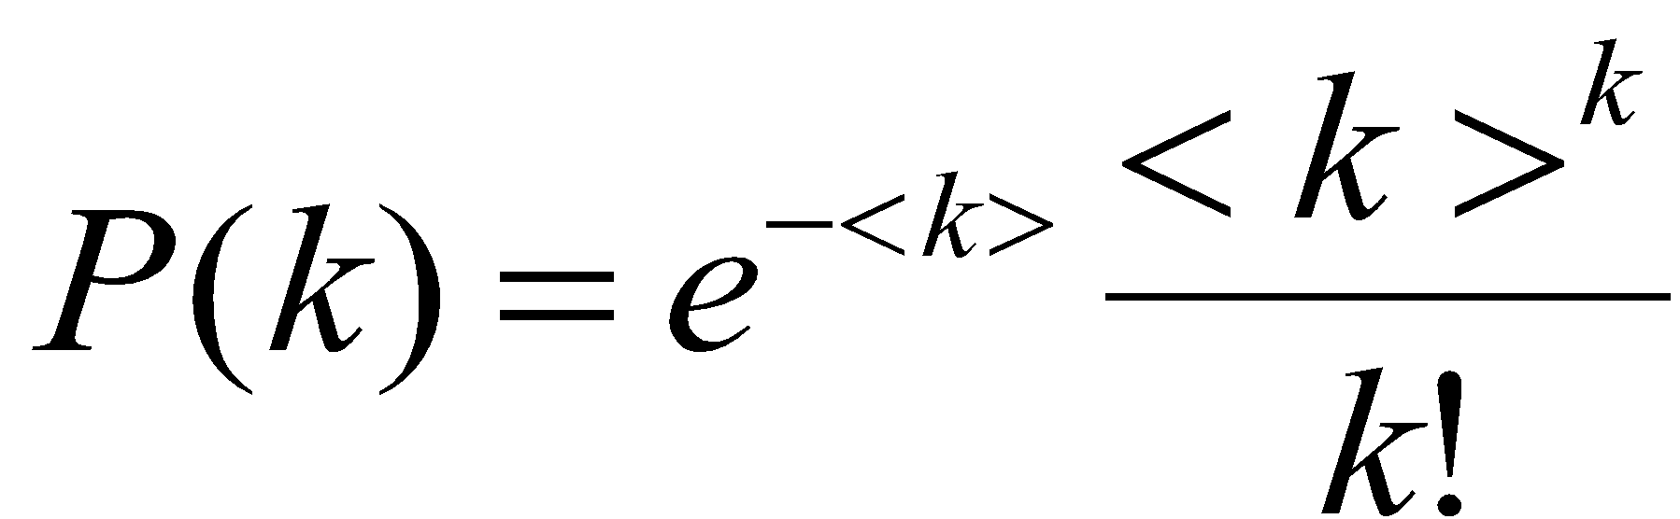
NO OUTLIERS IN A RANDOM SOCIETY
The most connected individual has degree k_{max}~1,185
The least connected individual has degree k_{min} ~ 816
The probability to find an individual with degree k>2,000 is 10⁻²⁷. Hence the chance of finding an individual with 2,000 acquaintances is so tiny that such nodes are virtually inexistent in a random society.
a random society would consist of mainly average individuals, with everyone with roughly the same number of friends.
It would lack outliers, individuals that are either highly popular or recluse.
Network Science: Random Graphs
Notes:
How different are really the node degrees in a random network? To get a feel for this difference, let us assume that the random network model is a good model for social networks. According to sociological research, a typical person knows about 1,000 individuals on a first name basis, so we take $\langle k \rangle \approx 1000$ and estimate the likelihood to observe nodes with degrees that are significantly different from $k = 1000$. Using Eq. (\ref{E-RG-Poisson} we find that the probability to find an individual with degree $k>2000$, i.e. one that has at least twice as many friends as the average person, is $\approx 10^{-27}$. Given that the Earth's population is about $10^9$, the chance of finding an individual with 2,000 acquaintances is so small that such nodes are virtually inexistent in a random society. In other words, highly connected nodes are practically forbidden in a random network. That is, a random society would consist of mainly average individuals, where everyone has roughly the same number of friends. It would lack outliers, individuals that are either highly popular or recluse.
‹#›

Slide 21
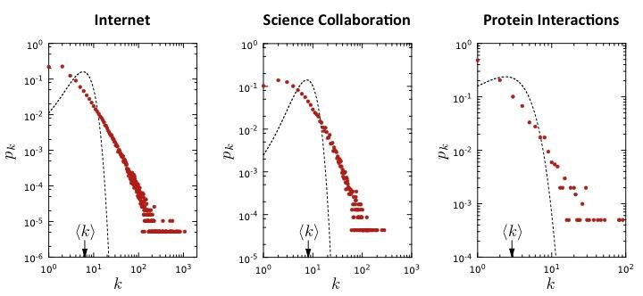
FACING REALITY: Degree distribution of real networks
Notes:
The Poisson form significantly underestimates the number of high degree nodes. That is, in real networks we see degrees that are orders of magni- tude higher that ⟨k⟩, which are forbidden by the predicted pk.
The spread in the degrees of real networks is much wider than expected in a random network. This difference is captured by the dispersion σk. The dispersion of a random network is σk = ⟨k⟩1/2 (see Figure 5). Using the average degrees listed in Table 1, for the three networks whose degree distribution shown in Fig. 7 we expect σinternet = 2.52, σcollaboration = 4.02, σyeast = 1.70. In contrast, the measurements indicate that the dispersion of these networks is σinternet = 14.14, σcollaboration = 21.27, σyeast = 4.88, significantly higher than predicted. Therefore in real networks the degrees vary far more widely than predicted by random network theory. All networks listed in Table 1 share this property.
‹#›

Slide 22
Section 6
The evolution of a random network

Slide 23
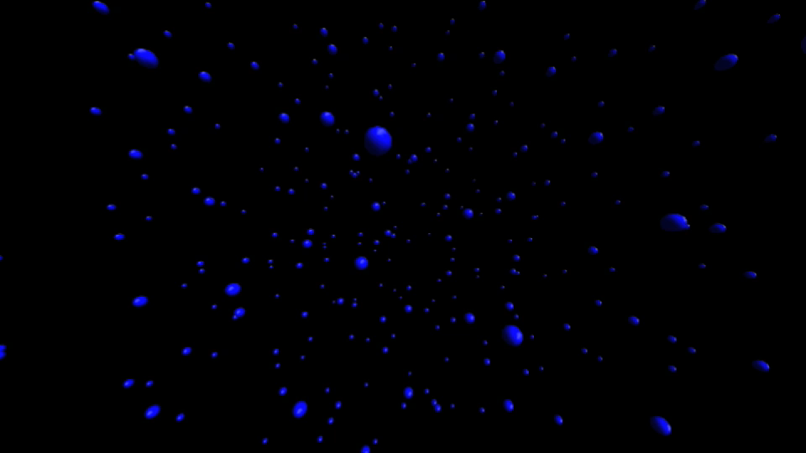

Slide 24
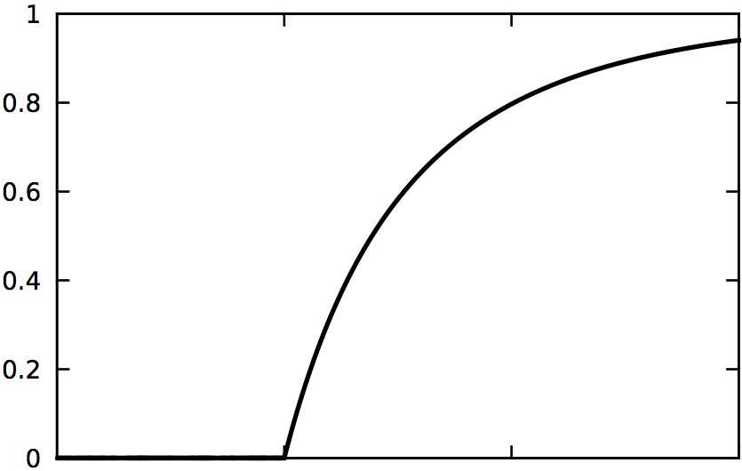
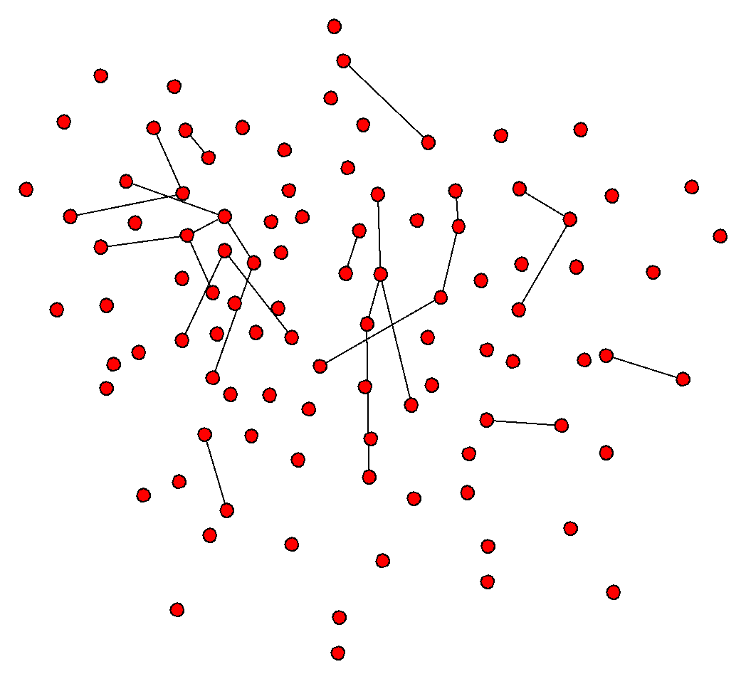
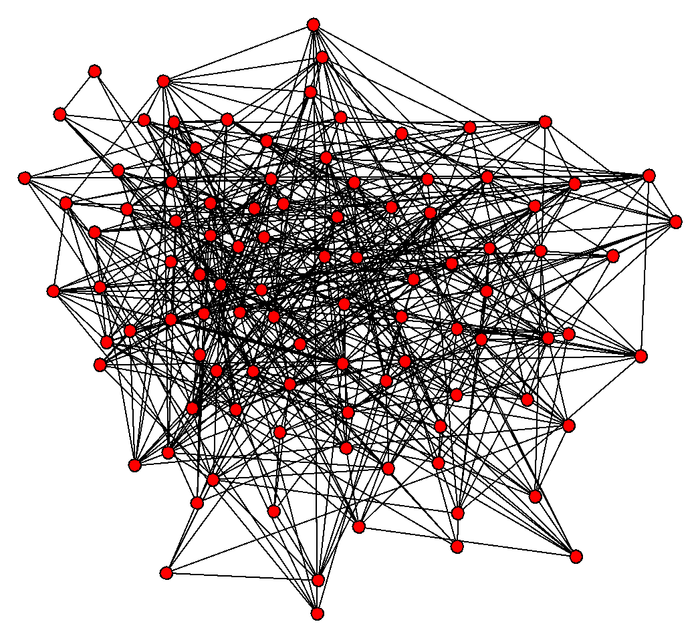
EVOLUTION OF A RANDOM NETWORK
disconnected nodes 🡺 NETWORK.
<k>
How does this transition happen?

Slide 25
EVOLUTION OF A RANDOM NETWORK
disconnected nodes 🡺 NETWORK.
<k_{c}>=1 (Erdos and Renyi, 1959)
The fact that at least one link per node is necessary to have a giant component is not unexpected. Indeed, for a giant component to exist, each of its nodes must be linked to at least one other node.
It is somewhat unexpected, however that one link is sufficient for the emergence of a giant component.
It is equally interesting that the emergence of the giant cluster is not gradual, but follows what physicists call a second order phase transition at <k>=1.

Slide 26
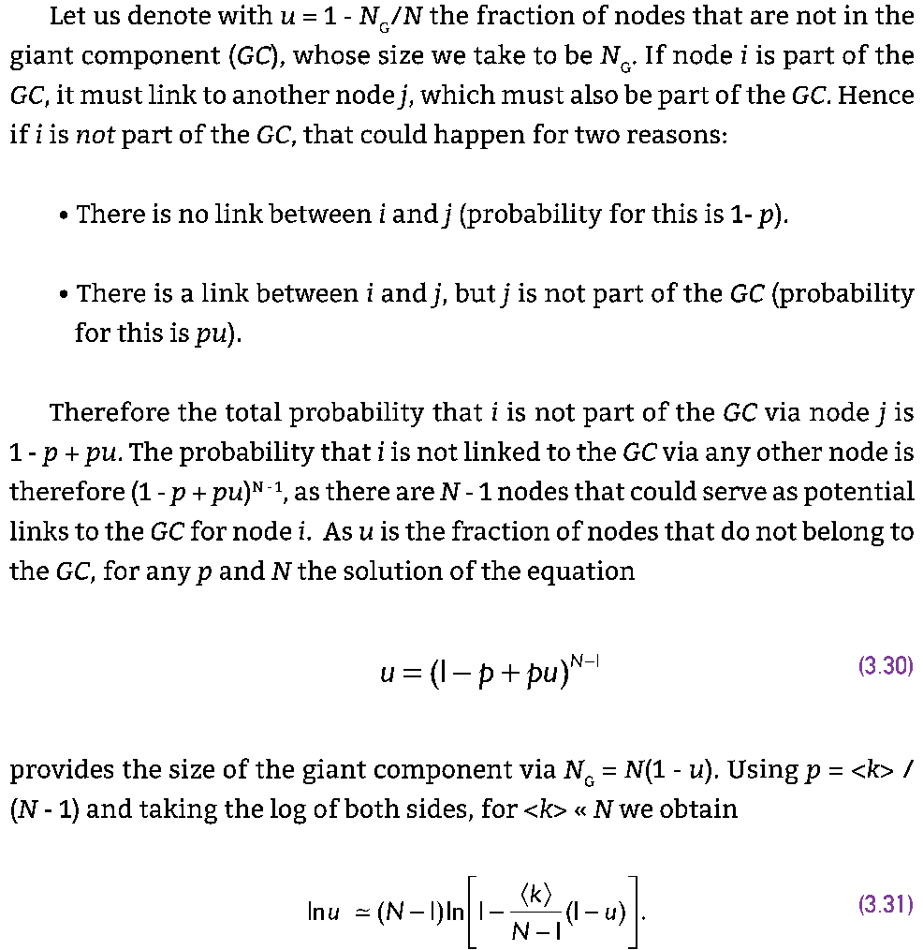

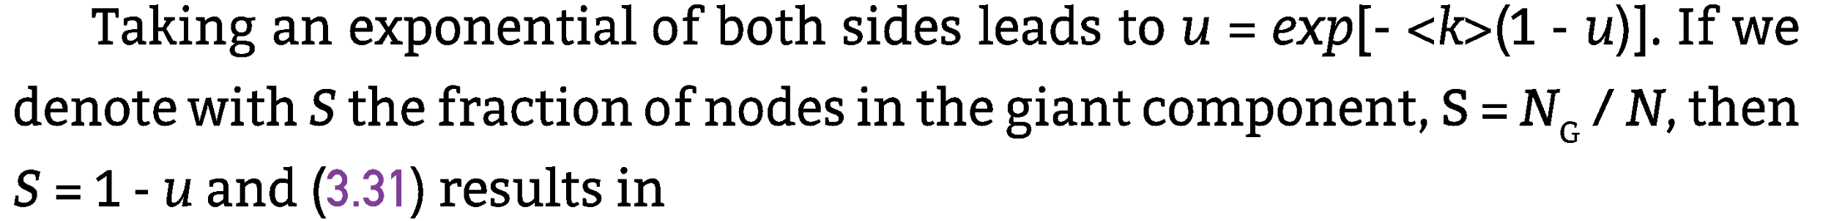
Section 3.4

Slide 27

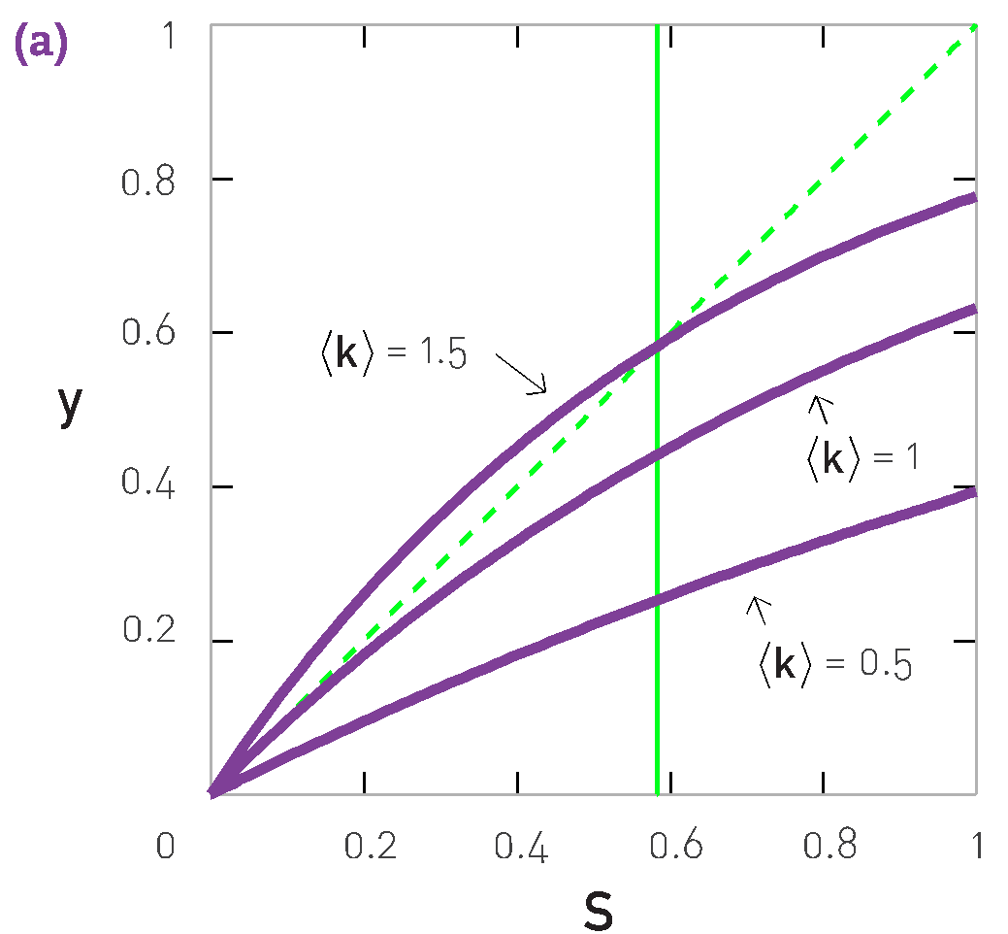
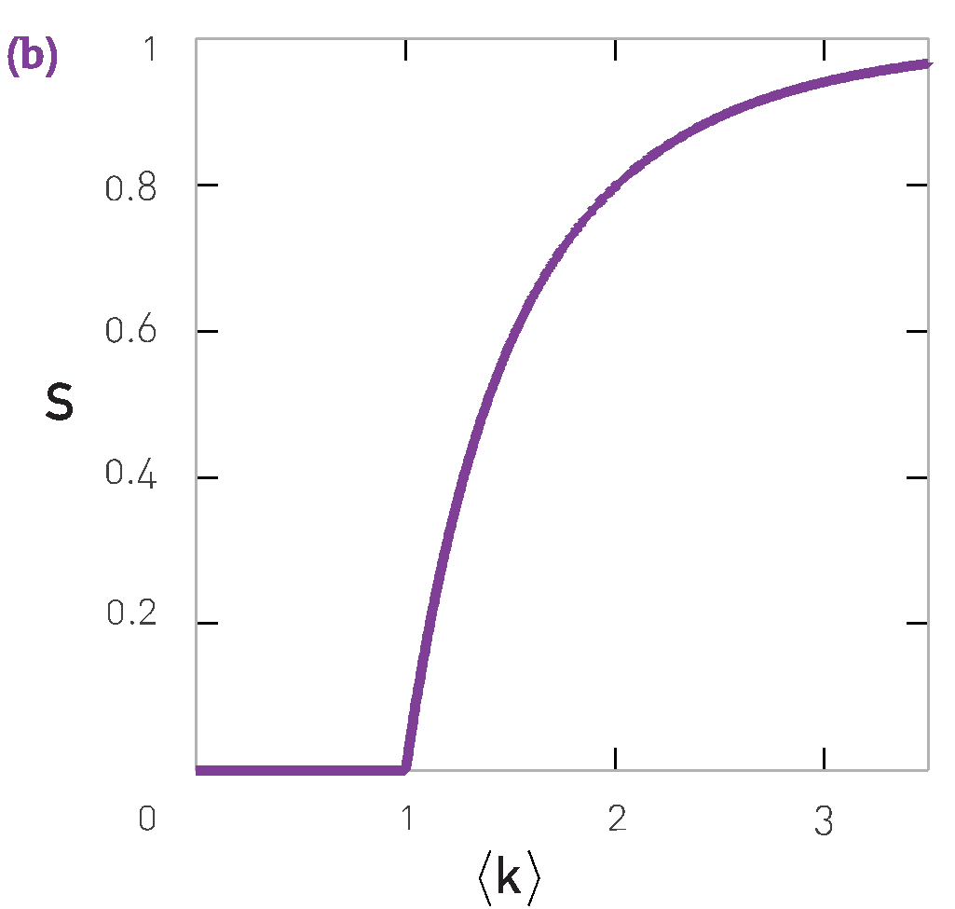
Section 3.4

Slide 28
EVOLUTION OF A RANDOM NETWORK
disconnected nodes 🡺 NETWORK.
<k>
How does this transition happen?

Slide 29
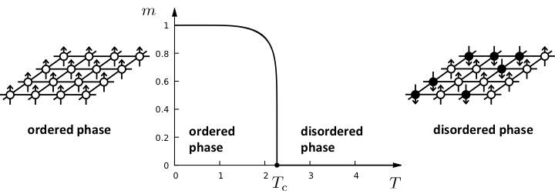
Phase transitions in complex systems I: Magnetism

Slide 30
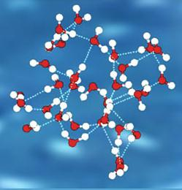
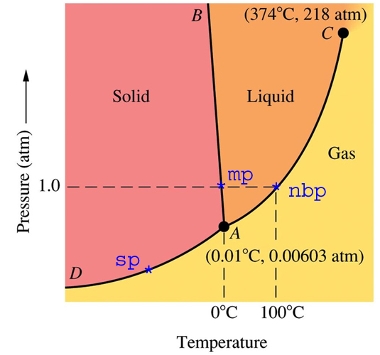
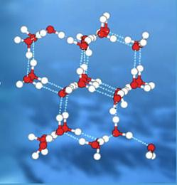
Phase transitions in complex systems I: liquids
Water
Ice
Notes:
The freezing of a liquid and the emergence of magnetization is magnetic material are examples of phase transitions representing transitions from disorder to order. Indeed, relative to the perfect order of the crystalline ice, liquid water is rather disorganized. Similarly, the randomly oriented spins in a ferromagnetic metal are in a state of disorder, taking up the highly ordered common orientation once cooled under Tc. Physicists studying phase transition in the 1960s and 70s, discovered that many properties of a system undergoing a phase transition are rather universal, that is, they are the same in a wide range of systems, from magnetism to magma freezing into rock, a metal becoming a magnet, or a ceramic material turning into a superconductor. For example, near the phase transition point, called the critical point, many quantities of interest follow power-laws. In may ways the emergence of the giant component in a random network reminds us of a phase transition. for example
For ⟨k⟩ < 1 and ⟨k⟩ > 1 the cluster sizes follow as exponential distribution. Right at the phase transition point p(s) follows a power law, as predicted by Eq. (15), suggesting the coexistence of components (clusters) of rather different sizes. similarly, as we approach the freezing point, ice crystals of rather different sizes appear, or as we approach the critical temperature of a mag- net, domains of atoms with spins pointing in the same direction, with widely different sizes, are observed, their size distribution following a power law.
In a random network the average size ⟨s⟩ of a cluster to which a randomly chosen node belongs to diverges as we approach ⟨k⟩ = 1, again a common signature of systems approaching their critical point. Indeed, right at the critical point the size of the ice crystals or of the magnetic domains diverges, assuring that the whole system becomes a single frozen crystal or that all spins point in the same direction in the magnetic phase.
‹#›

Slide 31
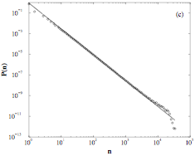







CLUSTER SIZE DISTRIBUTION
Probability that a randomly selected node belongs to a cluster of size s:
The distribution of cluster sizes at the critical point, displayed in a log-log plot. The data represent an average over 1000 systems of sizes
The dashed line has a slope of
At the critical point <k>=1
Derivation in Newman, 2010
Network Science: Random Graphs

Slide 32



I:
Subcritical
<k> < 1
II:
Critical
<k> = 1
III:
Supercritical
<k> > 1
IV:
Connected
<k> > ln N
<k>
N=100
<k>=0.5
<k>=1
<k>=3
<k>=5

Slide 33
I:
Subcritical
<k> < 1
p < p_{c}=1/N
<k>
No giant component.
N-L isolated clusters, cluster size distribution is exponential
The largest cluster is a tree, its size ~ ln N

Slide 34

II:
Critical
<k> = 1
p=p_{c}=1/N
<k>
Unique giant component: N_{G}~ N^{2/3}
contains a vanishing fraction of all nodes, N_{G}/N~N^{-1/3}
Small components are trees, GC has loops.
Cluster size distribution: p(s)~s^{-3/2}
A jump in the cluster size:
N=1,000 🡪 ln N~ 6.9; N^{2/3}~95
N=7 10⁹ 🡪 ln N~ 22; N^{2/3}~3,659,250

Slide 35

III:
Supercritical
<k> > 1
p > p_{c}=1/N
<k>=3
<k>
Unique giant component: N_{G}~ (p-p_{c})N
GC has loops.
Cluster size distribution: exponential

Slide 36
IV:
Connected
<k> > ln N
p > (ln N)/N
<k>=5
<k>
Only one cluster: N_{G}=N
GC is dense.
Cluster size distribution: None

Slide 37


Slide 38



Network evolution in graph theory

Slide 40
Section 7
Real networks are supercritical

Slide 41


Section 7
Notes:
The measurements indicate that real networks extrava- gantly exceed the ‹k› = 1 threshold. Indeed, sociologists es- timate that an average person has around 1,000 acquain- tances; a typical neuron is connected to dozens of other neurons, some to thousands; in our cells, each molecule takes part in several chemical reactions, some, like water, in hundreds.
Hence the average degree of real networks is well beyond the ‹k› = 1 threshold, implying that they all have a giant component.
Let us now inspect if we have single component (if ‹k› > lnN), or we expect the network to be fragmented into multiple components (if ‹k› < lnN ). For social networks this would mean that ‹k› ≥ ln(7 ×109) ≃ 22.7. That is, if the average individual has more than two dozens acquain- tances, then a random society would have a single com- ponent, leaving no node disconnected. With ‹k› ≃ 1,000 this is clearly satisfied. Yet, according to Table 3.1 most real networks do not satisfy this criteria, indicating that they should consist of several disconnected components. This is a disconcerting prediction for the Internet, as it suggests that we should have routers that, being disconnected from the giant component, are unable to communicate with other routers. This prediction is at odd with reality, as these routers would be of little utility.
Taken together, we find that most real networks are in the supercritical regime (Image 3.8). This means that these networks have a giant component, but it coexists with many disconnected components and nodes. This is true, however, only if real networks are accurately described by the Erdős-Rényi model, i.e. if real networks are random. In the coming chapters, as we learn more about the structure of real networks, we will understand why real networks can stay connected despite failing the k > lnN criteria.
‹#›

Slide 42
Section 3.8
Small worlds

Slide 43


















SIX DEGREES small worlds
Ralph
Sarah
Jane
Peter
Frigyes Karinthy, 1929
Stanley Milgram, 1967

Slide 44

SIX DEGREES 1929: Frigyes Kartinthy
1929: Minden másképpen van (Everything is Different)
Láncszemek (Chains)
“Look, Selma Lagerlöf just won the Nobel Prize for Literature, thus she is bound to know King Gustav of Sweden, after all he is the one who handed her the Prize, as required by tradition. King Gustav, to be sure, is a passionate tennis player, who always participates in international tournaments. He is known to have played Mr. Kehrling, whom he must therefore know for sure, and as it happens I myself know Mr. Kehrling quite well.”
"The worker knows the manager in the shop, who knows Ford; Ford is on friendly terms with the general director of Hearst Publications, who last year became good friends with Arpad Pasztor, someone I not only know, but to the best of my knowledge a good friend of mine. So I could easily ask him to send a telegram via the general director telling Ford that he should talk to the manager and have the worker in the shop quickly hammer together a car for me, as I happen to need one."
Frigyes Karinthy (1887-1938)
Hungarian Writer
Network Science: Random Graphs
Notes:
‹#›

Slide 45

SIX DEGREES 1967: Stanley Milgram
HOW TO TAKE PART IN THIS STUDY
1. ADD YOUR NAME TO THE ROSTER AT THE BOTTOM OF THIS SHEET, so that the next person who receives this letter will know who it came from.
2. DETACH ONE POSTCARD. FILL IT AND RETURN IT TO HARVARD UNIVERSITY. No stamp is needed. The postcard is very important. It allows us to keep track of the progress of the folder as it moves toward the target person.
3. IF YOU KNOW THE TARGET PERSON ON A PERSONAL BASIS, MAIL THIS FOLDER DIRECTLY TO HIM (HER). Do this only if you have previously met the target person and know each other on a first name basis.
4. IF YOU DO NOT KNOW THE TARGET PERSON ON A PERSONAL BASIS, DO NOT TRY TO CONTACT HIM DIRECTLY. INSTEAD, MAIL THIS FOLDER (POST CARDS AND ALL) TO A PERSONAL ACQUAINTANCE WHO IS MORE LIKELY THAN YOU TO KNOW THE TARGET PERSON. You may send the folder to a friend, relative or acquaintance, but it must be someone you know on a first name basis.
Network Science: Random Graphs

Slide 46

SIX DEGREES 1967: Stanley Milgram
Network Science: Random Graphs

Slide 47

SIX DEGREES 1991: John Guare
"Everybody on this planet is separated by only six other people. Six degrees of separation. Between us and everybody else on this planet. The president of the United States. A gondolier in Venice…. It's not just the big names. It's anyone. A native in a rain forest. A Tierra del Fuegan. An Eskimo. I am bound to everyone on this planet by a trail of six people. It's a profound thought. How every person is a new door, opening up into other worlds."
Network Science: Random Graphs
Notes:
The phrase was invented by the playwright John Guare, who used it as the title of his Broadway play writer in 1991, that was eventually turned into a movie with the same title. In the play the lead character, Ousa, musing about our interconnectedness, tells her daughter:
‹#›

Slide 48

WWW: 19 DEGREES OF SEPARATION
Image by Matthew Hurst
Blogosphere
Network Science: Random Graphs

Slide 49



DISTANCES IN RANDOM GRAPHS
Random graphs tend to have a tree-like topology with almost constant node degrees.
Network Science: Random Graphs
Notes:
‹#›

Slide 50


DISTANCES IN RANDOM GRAPHS
In most networks this offers a better approximation to the average distance between two randomly chosen nodes, ⟨d⟩, than to d_{max} .
We will call the small world phenomena the property that the average path length or the diameter depends logarithmically on the system size. Hence, ”small” means that ⟨d⟩ is proportional to log N, rather than N.
The 1/log⟨k⟩ term implies that denser the network, the smaller will be the distance between the nodes.
Network Science: Random Graphs
Notes:
Strictly speaking Eq. (22) predicts the scaling of the network diameter, dmax. Yet, in most networks (22) offers a better approximation to the average distance between two randomly chosen nodes, ⟨d⟩, than to dmax (see Table 2). This is because ⟨d⟩ is averaged over all pairs of nodes. Hence large fluctuations in d are diminished by the averaging. In contrast dmax is often dominated by a few extreme paths. Hence most of the small world property is not defined via Eq. (22), but rather using
⟨d⟩ ∝ log N . (23) log⟨k⟩
(ii) In real networks we expect systematic corrections to (22), rooted in the fact that the number of nodes at distance d > ⟨d⟩ drops significantly, deviating from the ⟨k⟩d prediction. Hence Eq. (19) is not valid for large d values, the resulting correction being discussed in Appendix 3.F.
(iii) The logarithm dependence of ⟨d⟩ on N predicts that ⟨d⟩ is orders of magnitude smaller than the size of the network (indeed, log(N) << N). We will call the small world phenomena the property that the average path length or the diameter depends logarithmically on the system size. Hence, ”small” means that ⟨d⟩ is proportional to logN, rather than N, as captured by Eq. (23).
(iv) The 1/log⟨k⟩ term implies that denser the network, the smaller will be the distance between the nodes.
‹#›

Slide 51

DISTANCES IN RANDOM GRAPHS compare with real data
Given the huge differences in scope, size, and average degree, the agreement is excellent.

Slide 52

Why are small worlds surprising? Suprising compared to what?
Network Science: Random Graphs
Notes:
Much of our intuition about distance is based on our experience with the phys- ical space, or distances in regular lattices. These do not display the small world phenomenon. Indeed, for a one-dimensional lattice (a line of length N) the network diameter and the average path length scale linearly with N: dmax ∼ ⟨d⟩ ∼ N. For a square lattice dmax ∼ ⟨d⟩ ∼ N1/2 and for a cubic lattice dmax ∼ ⟨d⟩ ∼ N1/3. In general, for a d-dimensional lattice we have dmax ∼ ⟨d⟩ ∼ N1/d. This polynomial form predicts a much faster increase than the logarithmic form Eq. (23) for a random network, indicating that in regular lattices the path lengths are significantly longer than in a random net- work. This difference is illustrated in the figure above that shows the predicted N-dependence of ⟨d⟩ (or dmax), for various regular and random networks. The right panel shows the same dependence on a log-log scale. For example, if the social network would form a regular 2d lattice, where each individual knows only those in its immediate physical vicinity, the typical distance between two randomly chosen individuals would be roughly (7 × 107)1/2 = 83, 666. Even if we correct for the fact that a person has about 1,000 acquaintances, not four, the average separation will be orders of magnitude larger than predicted by Eq. (22). Many laws of nature rely on precise distance measures: Newton’s law of gravi- tation is expressed in terms of the distance between two planets; the likelihood of two individuals to know each other decreases rapidly with the physical dis- tance between them. In networks the path length plays the role of the physical distance. Yet, as the path length depends on logN, many systems can have comparable diameter, making it difficult to distinguish them based on their average or maximum path length.
‹#›

Slide 53


Three, Four or Six Degrees?
For the globe’s social networks:
⟨k⟩ ≃ 10³
N ≃ 7 × 10⁹ for the world’s population.
Notes:
Using Facebook’s social graph of May 2011, consisting of 721 million active users and 68 billion symmetric friendship links, researchers found an average distance 4.74 between the users (Figure 3.12b). Therefore, the study detected only ‘four degrees of separation’ [18], closer to the prediction of (3.20) than to Milgram’s six degrees [21, 22].
‹#›

Slide 54

Image by Matthew Hurst
Blogosphere

Slide 55
Section 9
Clustering coefficient

Slide 56




CLUSTERING COEFFICIENT
Since edges are independent and have the same probability p,
The clustering coefficient of random graphs is small.
For fixed degree C decreases with the system size N.
C is independent of a node’s degree k.
Notes:
Equation (25) makes two predictions:
(i) For fixed degree ⟨k⟩, the larger the network, the smaller a node’s clustering coefficient, decreasing as N−1. Hence the average clustering coeffi- cient ⟨C⟩, should also decrease as N−1.
(ii) The local clustering coefficient of a node in a random network is in- dependent of the node’s degree.
‹#›

Slide 57

CLUSTERING COEFFICIENT
C decreases with the system size N.
C is independent of a node’s degree k.
Network Science: Random Graphs
Notes:
Equation (25) makes two predictions:
(i) For fixed degree ⟨k⟩, the larger the network, the smaller a node’s clustering coefficient, decreasing as N−1. Hence the average clustering coefficient ⟨C⟩, should also decrease as N−1.
(ii) The local clustering coefficient of a node in a random network is in- dependent of the node’s degree.
Taken together, we find that the random network model does not capture the local clustering of real networks. In- stead real networks have a much higher clustering coeffi- cient than expected for a random network of similar N and L, and high-degree nodes tend to have a smaller clustering coefficient than low-degree nodes.
‹#›

Slide 58

Watts-Strogatz Model
Image by Matthew Hurst
Blogosphere

Slide 59
Section 10
Real networks are not random

Slide 60



ARE REAL NETWORKS LIKE RANDOM GRAPHS?
As quantitative data about real networks became available, we can
compare their topology with the predictions of random graph theory.
Note that once we have N and <k> for a random network, from it we can derive every measurable property. Indeed, we have:
Average path length:
Clustering Coefficient:
Degree Distribution:
Network Science: Random Graphs

Slide 61


PATH LENGTHS IN REAL NETWORKS
Prediction:
Real networks have short distances
like random graphs.
Network Science: Random Graphs

Slide 62


CLUSTERING COEFFICIENT
Prediction:
C_{rand} underestimates with orders of magnitudes the clustering coefficient of real networks.
Network Science: Random Graphs

Slide 63

THE DEGREE DISTRIBUTION
Prediction:
Data:
Network Science: Random Graphs

Slide 64
ARE REAL NETWORKS LIKE RANDOM GRAPHS?
As quantitative data about real networks became available, we can
compare their topology with the predictions of random graph theory.
Note that once we have N and <k> for a random network, from it we can derive every measurable property. Indeed, we have:
Average path length:
Clustering Coefficient:
Degree Distribution:
Network Science: Random Graphs

Slide 65
IS THE RANDOM GRAPH MODEL RELEVANT TO REAL SYSTEMS?
(B) Most important: we need to ask ourselves, are real networks random?
The answer is simply: NO
There is no network in nature that we know of that would be described by the random network model.
Network Science: Random Graphs
Notes:
You would not be in the class today if the society would not have internal organizing principles, that make its underlying network deviate from random. Schools, churches, cities, states, etc, are all examples of deviations from randomness, that affect the network topology
I would not be able to continue teaching this class if my molecules would decide to react with each other randomly. My very ability to stay alive is rooted in the organizing principles that govern the structure and the function of the cellular network, that results in deviations from randomness.
‹#›

Slide 66
IF IT IS WRONG AND IRRELEVANT, WHY DID WE DEVOT TO IT A FULL CLASS?
It is the reference model for the rest of the class.
It will help us calculate many quantities, that can then be compared to the real data, understanding to what degree is a particular property the result of some random process.
Patterns in real networks that are shared by a large number of real networks, yet which deviate from the predictions of the random network model.
In order to identify these, we need to understand how would a particular property look like if it is driven entirely by random processes.
While WRONG and IRRELEVANT, it will turn out to be extremly USEFUL!
Network Science: Random Graphs

Slide 67
Section 11
Summary

Slide 68

Erdös-Rényi MODEL (1960)
Network Science: Random Graphs
Notes:
The figure shows the yearly citations of the first two papers by Erd\H{o}s and R\'enyi, published in 1959 and 1960, that are interchangeably cited as the source of the Erd\H{o}s-R\'enyi model. The papers getting less then 10 citations for the first four decades after their publication. Their popularity exploded only after the three papers on scale-free networks \cite{Albert_Nature_1999}\cite{barab99}
‹#›

Slide 69


HISTORICAL NOTE
1951, Rapoport and Solomonoff:
🡪 first systematic study of a random graph.
🡪demonstrates the phase transition.
🡪natural systems: neural networks; the social networks of physical contacts (epidemics); genetics.
1959: G(N,p)
Anatol Rapoport
1911- 2007
Edgar N. Gilbert
(b.1923)
Why do we call it the Erdos-Renyi random model?
Network Science: Random Graphs
Notes:
This remarkable statement could easily serve as a manifesto for the revolution in the study of networks that has recently taken place, four decades later, in the physics and mathematics communities.
‹#›

Slide 70

HISTORICAL NOTE
Network Science: Random Graphs

Slide 71

NETWORK DATA: SCIENCE COLLABORATION NETWORKS
Erdos:
1,400 papers
507 coauthors
Einstein: EN=2
Paul Samuelson EN=5
….
ALB: EN: 3
Network Science: Random Graphs
Notes:
P\'al Erd\H{o}s is famous not only for his countless theorems and proofs, but also for a concept he inspired: the Erd\H{o}s number. Erd\H{o}s published over 1,400 papers with 507 co-authors. It is an unparalleled honor to be counted among his hundreds of co-authors. Short of this, it is a great distinction to be only two links from him. To keep track of their distance from Erd\H{o}s, mathematicians introduced the Erd\H{o}s number. Erd\H{o}s has Erd\H{o}s number zero. Those who co-authored a paper with him have Erd\H{o}s number one. Those who wrote a paper with an Erd\H{o}s co-author have Erd\H{o}s number two, and so on. Most mathematicians turn out to have rather small Erd\H{o}s numbers, being typically two to five steps from Erd\H{o}s. But his influence goes well beyond mathematics. Economists, physicists, and computer scientists also can be easily connected to him. Einstein has Erd\H{o}s number two. Paul Samuelson, the Nobel Prize winning economist, has five.
The very existence of the Erd\H{o}s number demonstrates that the scientific community forms a highly interconnected network in which all scientists are linked to each other through the papers they have written. Consequently, the web of science is a small-scale prototype of our social network, with the unique feature that its links are regularly published. As all scientific publications are recorded in computerized databases, this automatically creates a detailed digital record of the professional links between scientists.
‹#›

Slide 72

NETWORK DATA: SCIENCE COLLABORATION NETWORKS
Collaboration Network:
Nodes: Scientists
Links: Joint publications
Physical Review:
1893 – 2009.
N=449,673
L=4,707,958
See also Stanford Large Network
database
http://snap.stanford.edu/data/#canets.
Network Science: Random Graphs
Notes:
\bf Data source and mapping:} Several datasets have been studied lately to explore the science collaboration network, The most studied dataset captures the corpus of Physical Review publications, between 1893 and 2009, that can be requested from the American Physical Society. Several datasets are available at the Stanford Large Network database
CITE %\url{http://snap.stanford.edu/data/#canets}.
‹#›

Slide 73


Scale-free
Hierarchical
Network Science: Graph Theory

Slide 74

Network Science: Graph Theory

